Slide 1


St Joseph’s College Of Engineering
Solar powered
Smart irrigation using IOT
Prasath K
Naveen Kuvmar K
Navarasu M
Preethipan J
Guide : Dr.A.Jamna

Slide 2
Abstract
The Solar-Powered Smart Irrigation System aims to provide an IoT solution in automating the watering process using an Arduino-based microcontroller and sensors. The watering process is driven by the moisture content of the soil using sensors. Threshold limit are set for soil moisture sensor to ensure efficient and effective use of water resource. The main microcontroller unit controls the system whenever the sensor is across threshold value.With the integration of IoT, automated irrigation can be easily access and remotely monitored over the mobile application through a wireless communication device

Slide 3
Introduction
over the years, several development and innovation have come across to further minimize the rapid
depleting of natural resources in the environment. With the global energy crisis, initiative for moving towards application of renewable resources carried out as possible solution.
Now these days world moving towards renewable energy, on taking this into our concern we ended at doing ' Solar powered smart irrigation using IOT '.

Slide 4
Objectives
1.To design and implement a Solar-Powered Smart Irrigation System using IoT Approach
2.To build an energy-efficient and cost-effective system using renewable resources
3.To integrate the system using various sensor parameters such as temperature and humidity sensor, soil moisture sensors and tank storage capacity sensor to collect information
4.To monitor and track the system using IoT technology

Slide 5
Arduino Uno GSM Module Transistor BC547 (2) Connecting wires 16x2 LCD (optional) Power supply 12v 1A Relay 12v Water cooler pump Soil Moisture Sensor Resistors (1k, 10k) Variable Resister (10k, 100k) Terminal connector Voltage Regulator IC LM317
COMPONENTS

Slide 6
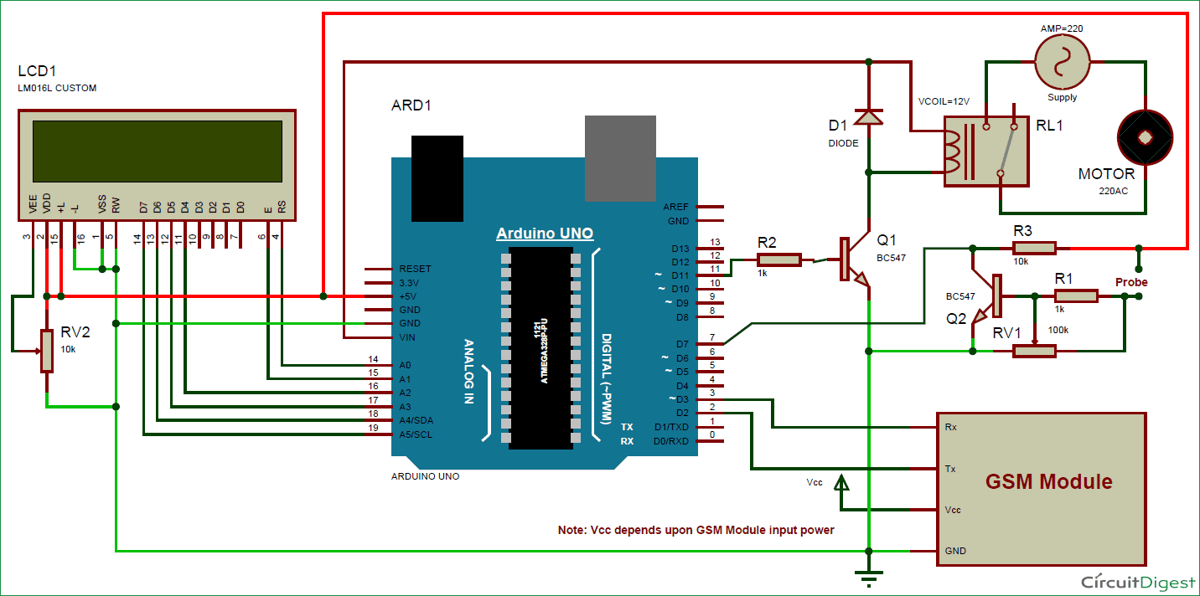
Circuit Diagram

Slide 7
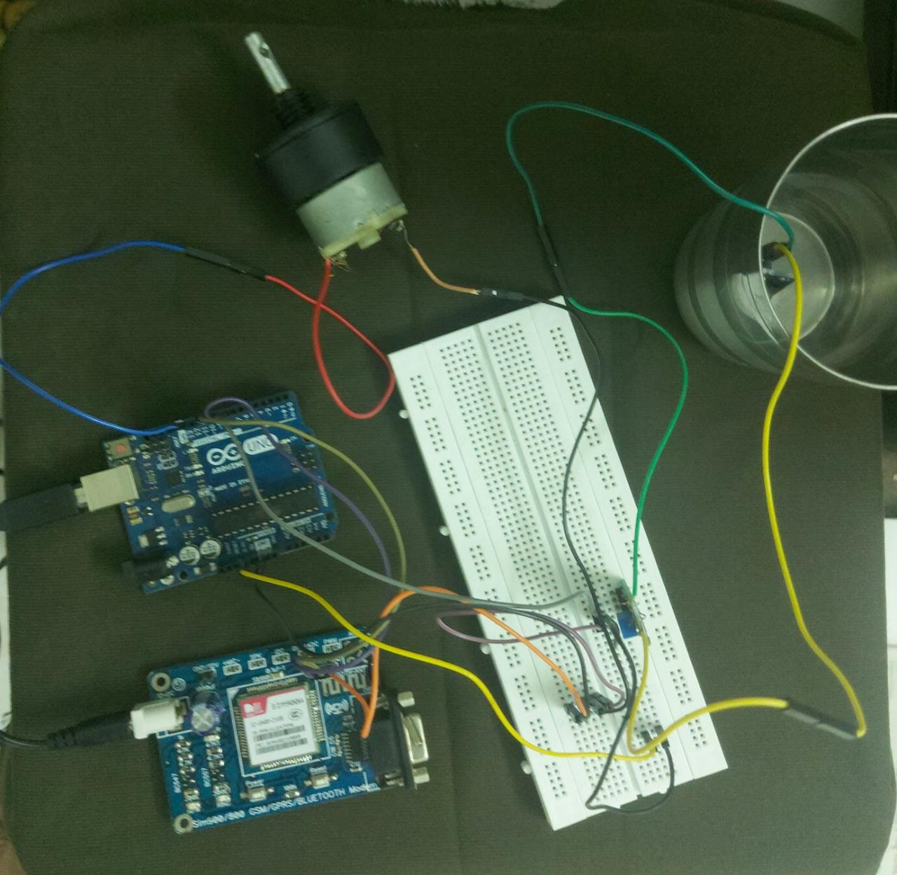

Slide 8
Working Principle
In This Plant Watering System, Soil Moisture Sensor checks the moisture level in the soil and if moisture level is low then Arduino switches On a water pump to provide water to the plant. Water pump gets automatically off when system finds enough moisture in the soil.
Whenever system switched On or off the pump, a message is sent to the user via GSM module, updating the status of water pump and soil moisture. This system is very useful in Farms, gardens, home etc. This system is completely automated and there is no need for any human intervention.

Slide 9
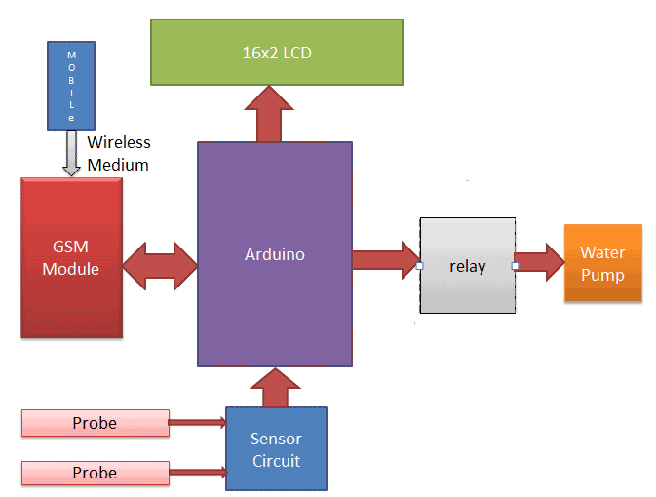
Check Conditions
1. If soil moisture content is greater than a fixed value, then there is no need of irrigation.
2. If the soil moisture content is less than a fixed value, then start irrigation.
3. If the water reaches the prescribed point of water level, then sensor gives data to system to stop the irrigation. Command sends to RelayModule

Slide 10
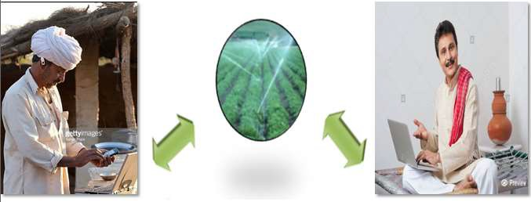
Farmer is getting SMS:
Motor: ON or OFF
Current moisture content (Ex. 50%)
Current water level (Ex: 90 DEPTH Feet)

Slide 11
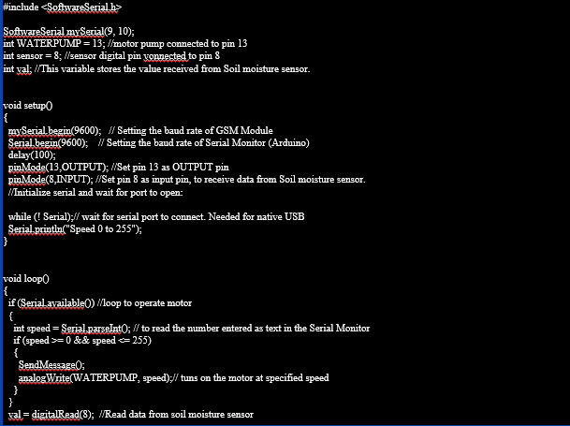
code

Slide 12
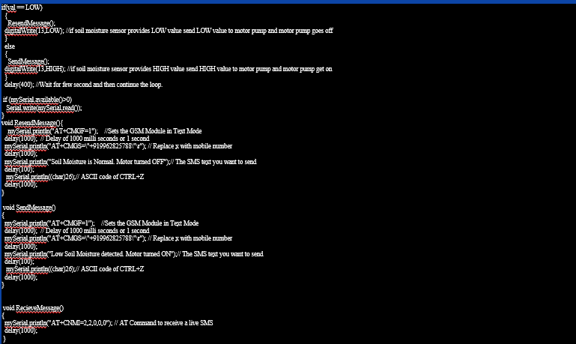
code

Slide 13
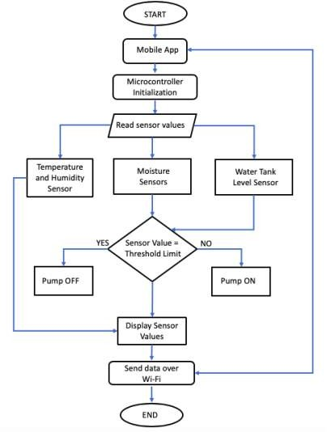
Flow Chart

Slide 14
ADVANTAGES
Increase in productivity
Reduced water consumption
Safe
No manpower required
Reduced soil erosion and nutrient leaching
Require smaller water sources

Slide 15
CONCLUSION
The solar powered smart irrigation system using IoT demonstrates a collection of data using sensors for productivity and efficiency. The generates a clean energy by utilizing the solar generation technology which improves cost management and waste reduction for overall improved system performance. The system also allows monitoring the irrigation process without manual intervention hence achieving optimized results and more efficient use of water resources. The system is set to deliver a more productive and sustainable irrigation method and beneficial to the environment.

Slide 16
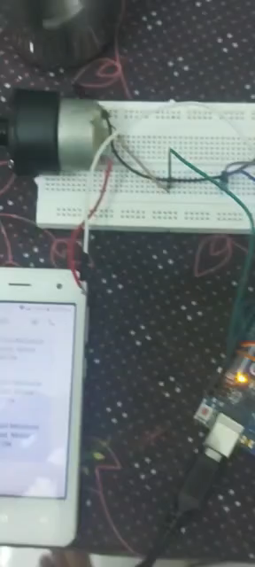

Slide 17
THANK YOU

